Slide 1

Interviewing: Tips & Techniques

Slide 2

Strategy for a successful interview
Preparation
Practice

Slide 3
Types of interviews
Screening calls (shorter than formal interview)
Typically with a recruiter, for 10-20 mins, might be over the phone or Teams/Zoom
Competency based interviews
Focused on behaviour: “tell me about a time when…”
Technical interviews
Designed to test your technical skills, understanding, and approach to problem-solving

Slide 4
The goal of the interviewer is…
Can you do the job?
Will you do the job?
Are you a good fit for the company?

Slide 5
The goal for you is to determine…
Do I want this internship?
Can I do this internship?
Does this internship offer me the experience I want?
Is this the kind of company I want to work for?

Slide 6

Research is Key!
Role
Company
You
“Fail to prepare, prepare to fail”

Slide 7
1. Researching the role
Start with the job description
Highlight key (technical) skills, requirements, responsibilities
What are the day-to-day activities?
Do you possess the skills, or some of, required for the role? (100% not needed!)
What are the key competencies required?
Does everything in the job description make sense?
Can you tie your experience (work, college projects, other experience) to the skills or competencies listed in the role description?

Slide 8
Group Exercise:
5 mins

Slide 9
2. Researching the company
What does the company actually do, and do you understand what they do?
What industry are they in? Do they operate locally or globally?
Do you know them beyond the generic “About” section on the website?
What are the values of the company?
Have they been in the news?
What can you find about their internship programme?
Go through their website, LinkedIn page, and other socials (Instagram, TikTok)
Do you know anyone who works there?

Slide 10
3. Researching YOU
Know your CV inside and out!
Can you talk about your experiences in a meaningful way?
Do you know your Projects well and can you explain them structurally?
Revisit your leadership experiences, achievements and awards and practice talking about them to show key skills or behavioural competencies.
Think about your interests, passions, and future aspirations outside what’s on your CV

Slide 11
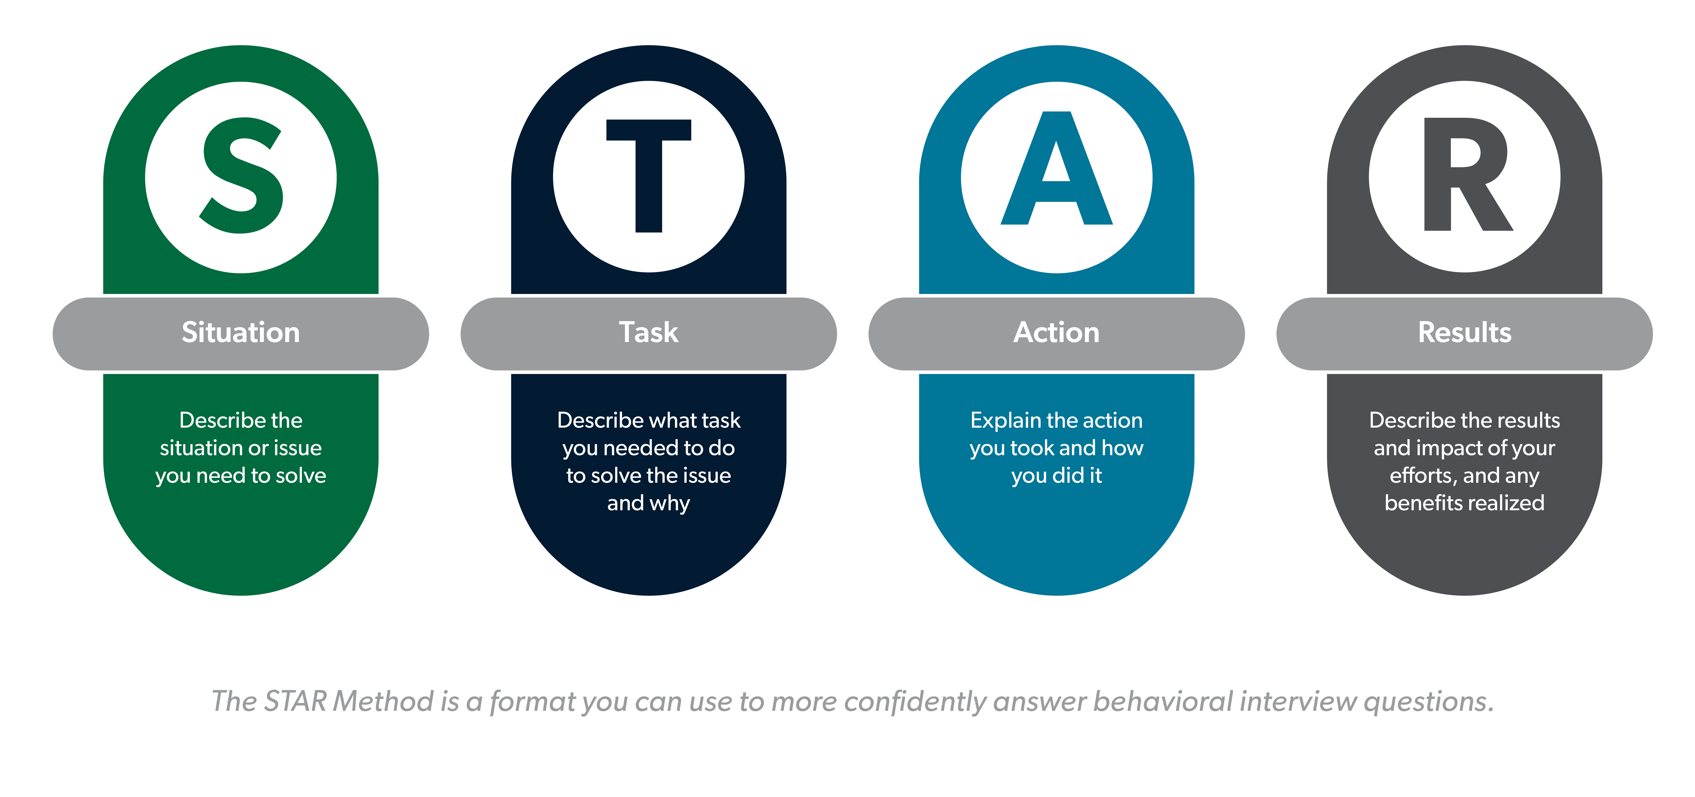
Competency Based Interviews

Slide 12
Competency Based Questions
Tell me about a time when… “you had to work as part of a team”. (Teamwork, Collaboration)
Tell me about a time when… “you had to communicate to a larger audience”. (Communication)
Please tell us about a situation where… “a project you worked on did not go as well as planned”. (Resilience, Problem-Solving)
Tell me about a time when… “you had to balance multiple priorities and how did you approach this”. (Time Management)
Please tell us about a situation where… “you had to learn something new to complete a task”. (Curiosity, Problem-Solving, Initiative)

Slide 13
How to approach these…
Describe the situation, set the scene, tell a story
Explain what the task was at hand and what did you want to achieve?
What did you do then? What action did you take? (Use “I” not “we”)
Describe the outcome. What were the results? What were your learnings? Was it the desired outcome?

Slide 14
Questions at the end
What not to ask?
What to ask?
Questions already answered
Questions on pay, holidays, other contract specifics
Sick days
Holiday commitments
Questions about the job itself
Questions about what the day-to-day would look like
Imagine you are successful in getting the internship, put yourself in the position of your first day: what questions would you have?

Slide 15
Final thoughts
Body language
Dress code
Tech set-up: wi-fi, quiet location, camera
Test everything beforehand!
Punctuality
And… if things go wrong, don’t panic – take a breath, take a couple seconds and revert to something you are comfortable talking about

